Slide 1
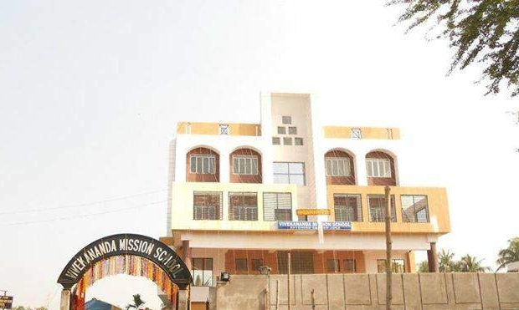
VIVEKANANDA MISSION SCHOOL
ADMISSION OPEN FOR NURSERY I AND NURSERY II
FOR THE SESSION 2022-2023

